Slide 1
Digital communication principles

Slide 2
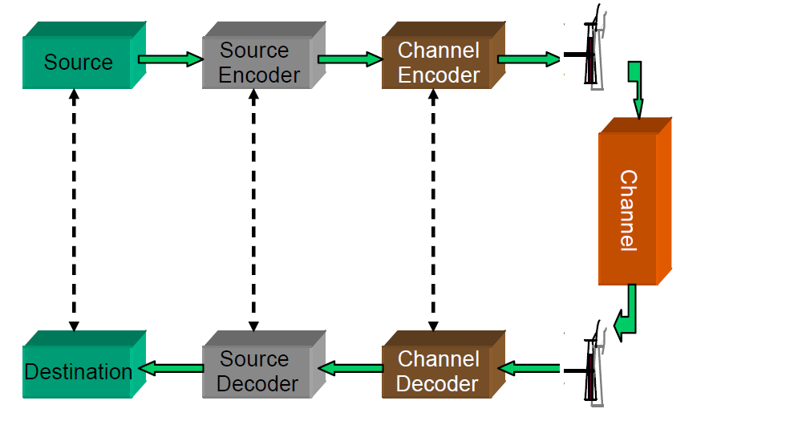
Digital communication systems

Slide 3
The source encoder

Slide 4
The source encoder
Source encoder can be discrete (encoder’s input is a sequence of symbols from a discrete alphabet like the latin alphabet; e.g. email message, web page) or analog (encoder’s input is a waveform like a speech waveform; e.g. speech, video)
Input: sequence of symbols or waveform
Output: sequence of bits (which will be the input of the channel encoder/modulator)
Goals of the encoder:
  represent data as binary sequence
  compress data

Slide 5
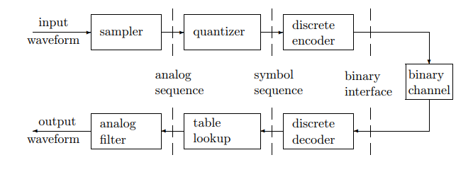
Detailed view of the source encoder
discrete source encoders require only the inner layer above
analog source encoders use all three layers

Slide 6
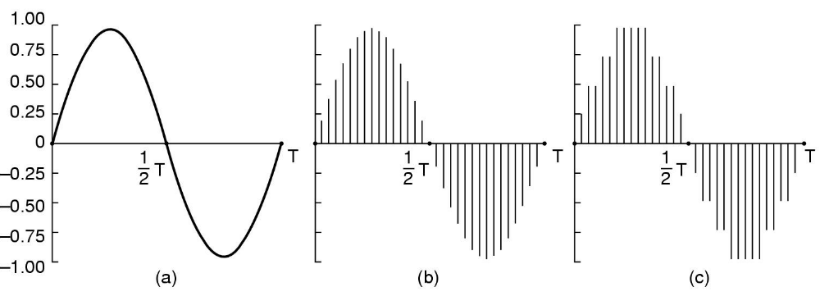
1)+2) Sampling & quantization
a) the input waveform
b) sampling the waveform
c) quantizing the samples to 3 bits (i.e. 2^3 = 8 quantization levels)

Slide 7
1)+2)Sampling and quantization examples
Telephone
  8.000 samples /sec (up to 4 KHz)
  Needs 64 Kb/s (Pulse code modulation, PCM, 8-bit samples in Europe), or 56 Kb/s (USA, Japan – 7 bits)
  Enhancements: Differential PCM, Adaptive DPCM
Audio CDs
  44.100 samples /sec (up to 20 KHz)
  16-bit samples: quantization error is small but audible (the dynamic range of the ear is ca. 1 million)
  Needs 705.6 Kb/s for mono, 1.411 Mb/s for stereo

Slide 8
3) Discrete Source encoding algorithms
main goal: compression
input: sequence of symbols from a finite alphabet (e.g. latin alphabet)
output: sequence of binary digits
must be uniquely decodable
two types of encoding algorithms:
  fixed code length algorithms: ASCII
  variable code length algorithms: Huffman, LZW

Slide 9
Variable length codes for discrete sources
A variable-length code C maps each source symbol a_{j} in a source alphabet X = {a₁, . . . , a_{M}} to a binary string C(a_{j}), called a codeword. The number of bits in C(a_{j}) is called the length l(a_{j}) of C(a_{j}).
For example, a variable-length code for the alphabet X = {a, b, c} and its lengths might be given by
C(a) = 0 l(a) = 1
C(b) = 10 l(b) = 2
C(c) = 11 l(c) = 2

Slide 10
Variable length codes for discrete sources (1)
A code C for a discrete source is uniquely decodable if, for any string of source symbols, say x₁, x₂, . . . , x_{n}, the concatenation of the corresponding codewords, C(x₁)C(x₂) · · · C(x_{n}), differs from the concatenation of the codewords C(x₁)C(x₂) · · · C(x_{m}) for any other string x₁, x₂, . . . , x_{m} of source symbols.
A prefix of a string y1 · · · yl is any initial substring y1 · · · ym, m ≤ l of that string. The prefix is proper if m < l. A code is prefix-free if no codeword is a prefix of any other
codeword. A prefix-free code is uniquely decodable.

Slide 11
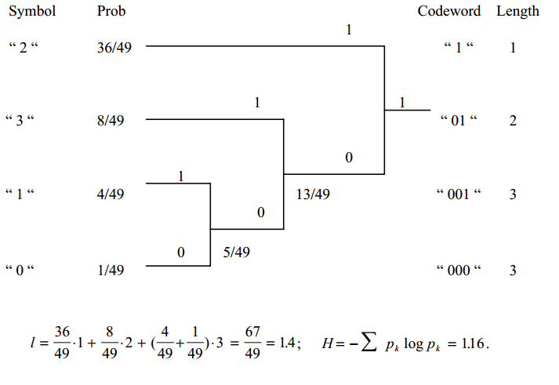
Huffman encoding example

Slide 12
Huffman encoding example (2)
Huffman encode the sequence of symbols {3,2,2,0,1,1,2,3,2,2} using the codes from previous slide
Code table:
Coded sequence: {01,1,1,000,001,001,1,01,1,1}
  Average bit rate: 18 bits/10=1.8 bits/symbol
  Fixed length coding rate: 2 bits/symbol
  Saving is more obvious for a longer sequence of symbol
Decoding: table lookup
Symbol | Codeword
0 | 000
1 | 001
2 | 1
3 | 01

Slide 13
Huffman encoding algorithm
Step 1: arrange the symbol probabilities in a decreasing order and consider them as leaf nodes of a tree
Step 2: while there are more than one node:
  Find the two nodes with the smallest probability and assign the one with the lowest probability a “0”, and the other one a “1” (or the other way, but be consistent)
  Merge the two nodes to form a new node whose probability is the sum of the two merged nodes.
  Go back to Step 1
Step 3: For each symbol, determine its codeword by tracing the assigned bits from the corresponding leaf node to the top of the tree. The bit at the leaf node is the last bit of the codeword

Slide 14
More on Huffman encoding
Huffman coding achieves the upper entropy bound
One can code one symbol at a time (scalar coding) or a group of symbols at a time (vector coding)
If the probability distribution is known and accurate, Huffman coding is very good (off from the entropy by 1 bit at most).

Slide 15
The LZW encoding algorithm
The encoder and decoder dynamically build a dictionary of (symbol-code) pairs. This dictionary is initialized with the ASCII codes set (codes 1-255 are already occupied).
The encoder always tries to add an unknown, long, symbol sequence to this dictionary and sends only the code for this sequence to the decoder (not the actual sequence)

Slide 16
The LZW encoding algorithm
Initialize dictionary with single character strings
P = first input character
WHILE not end of input stream
C = next input character
IF P + C is in the string table
P = P + C
ELSE
output the code for P
add P + C to the string table
P = C
END WHILE
output code for P

Slide 17
The LZW decoding algorithm
Initialize dictionary with single character strings
OLD = first input code
output translation of OLD
WHILE not end of input stream
NEW = next input code
IF NEW is not in the string table
S = translation of OLD
S = S + C
ELSE
S = translation of NEW
output S
C = first character of S
OLD + C to the string table
OLD = NEW
END WHILE

Slide 18
LZW encoding example (1)
Input: BABAAB Output: 66
P = B A
C = A
Dictionary:
255
256 BA

Slide 19
LZW encoding example (2)
Input: BABAAB Output: 66, 65
P = A B
C = B
Dictionary:
255
BA
AB

Slide 20
LZW encoding example (3)
Input: BABAAB Output: 66, 65
P = B BA
C = A
Dictionary:
255
BA
AB

Slide 21
LZW encoding example (4)
Input: BABAAB Output: 66, 65,256
P = BA A
C = A
Dictionary:
255
BA
AB
BAA

Slide 22
LZW encoding example (5)
Input: BABAAB Output: 66, 65,256
P = A AB
C = B
Dictionary:
255
BA
AB
BAA

Slide 23
LZW encoding example (6)
Input: BABAAB Final Output: 66, 65,256,257
P = AB
C =
Dictionary:
255
BA
AB
BAA

Slide 24
LZW decoding example (1)
Input: 66, 65,256,257 Output:BA
Old= 66 65
New=65
S=A
C=A
Dictionary:
255
256 BA

Slide 25
LZW decoding example (2)
Input: 66, 65,256,257 Output:BABA
Old= 65 256
New=256
S=BA
C=B
Dictionary:
255
BA
AB

Slide 26
LZW decoding example (3)
Input: 66, 65,256,257 Final Output:BABAAB
Old= 256 257
New=257
S=AB
C=A
Dictionary:
255
BA
AB
BAA

Slide 27
The channel encoder (Modulator)
Has as input a binary sequence produced by the source encoder
Produces a waveform signal suitable for being transmitted over a (wireless) channel

Slide 28
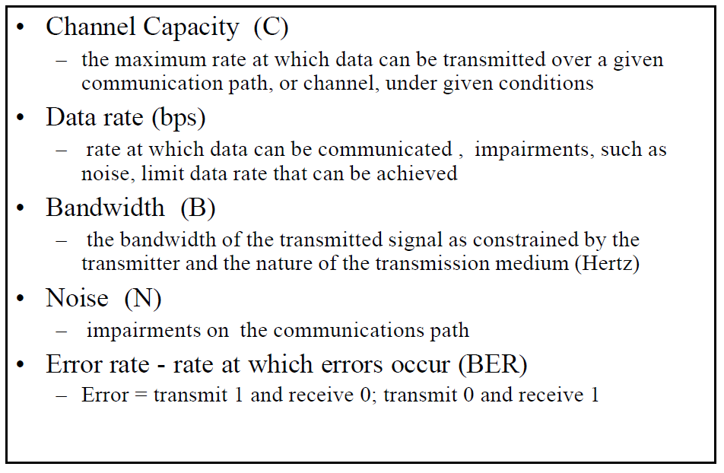
Channel capacity

Slide 29
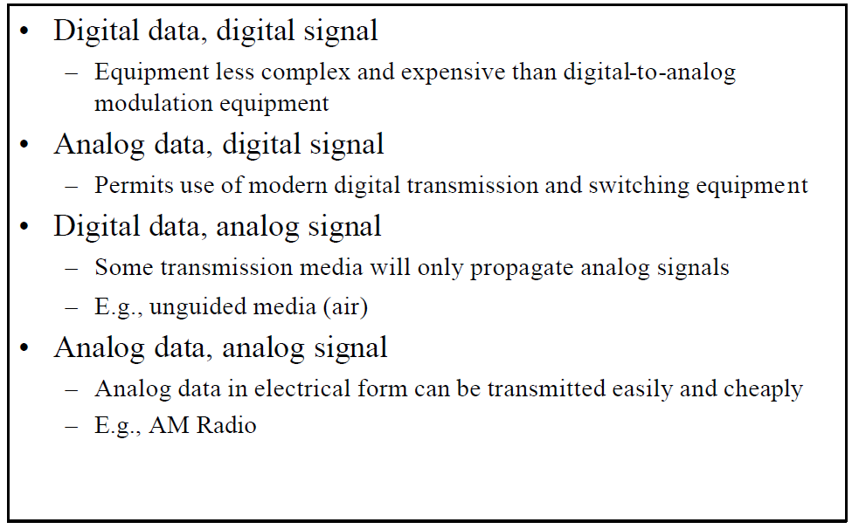
Reasons for choosing encoding techniques

Slide 30
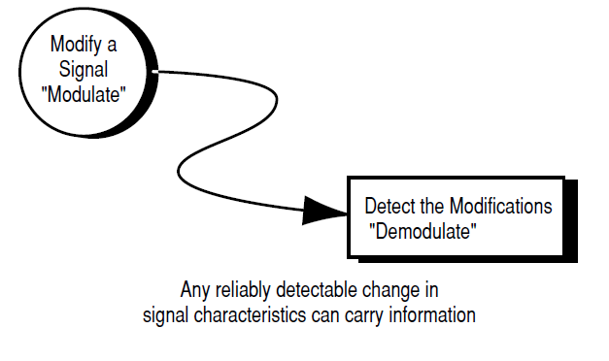
What is modulation ?
Modulation = Adding information to a carrier signal
The sine wave on which the characteristics of the information signal are modulated is called a carrier signal

Slide 31
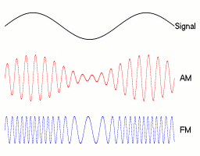
Analog modulation

Slide 32
Simple digital modulation and demodulation

Slide 33
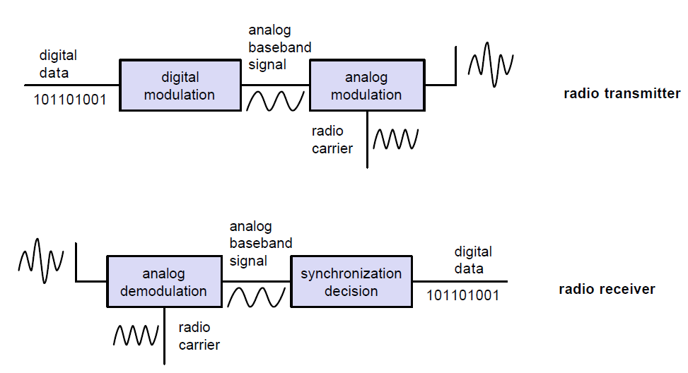
Simple digital modulation and demodulation schemes

Slide 34
Signal characteristics that can be modified
  signal x(t) = A cos(2πft + Φ)
  A – amplitude
  f – frequency
  Φ – phase (initial angle of the sinusoidal function at its origin)

Slide 35
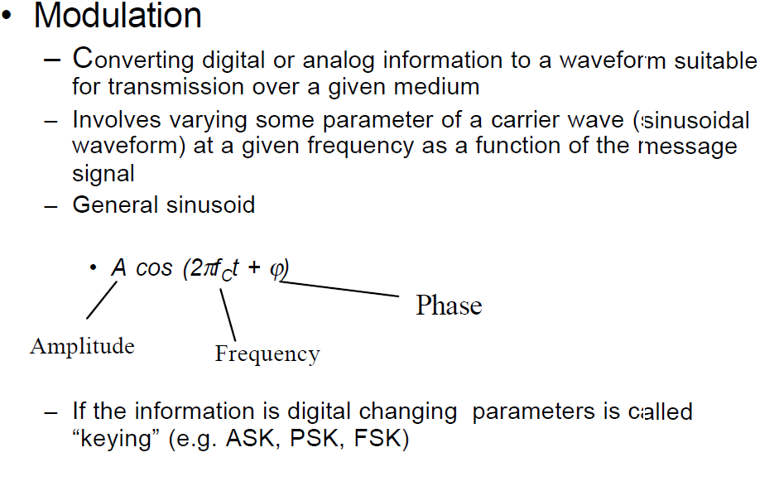
Modulation

Slide 36
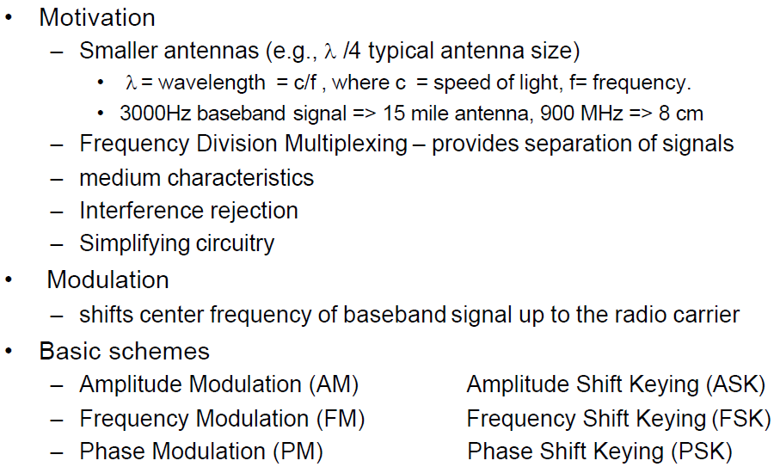
Modulation (1)

Slide 37
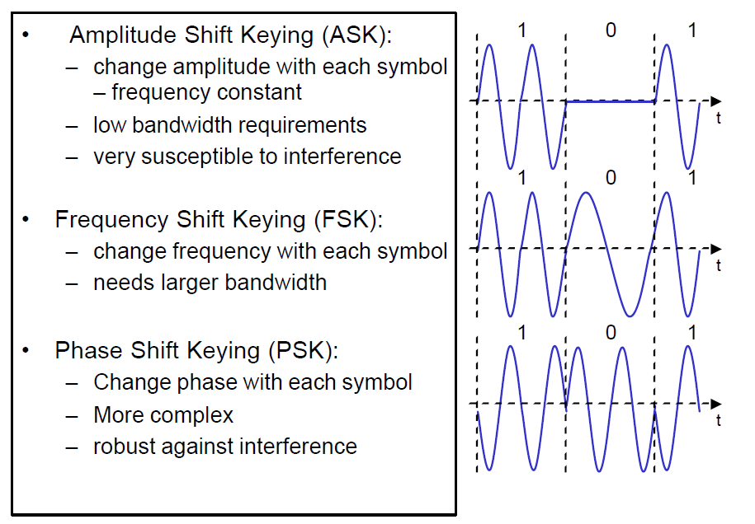
Simple digital modulation techniques

Slide 38
Simple digital modulation techniques
In the following slides we briefly present binary ASK/ FSK/ PSK which are binary digital modulation schemes that encode each bit (0 or 1) into a separate waveform which is transmitted for a finite time interval T (i.e. the symbol duration interval)
However these are rather inefficient, usually a block of b consecutive bits is mapped onto a symbol (also called a signal), all symbols generated are then transformed into a real waveform function which is then shifted up to the passband frequency band and transmitted (to be discussed in the complex modulation techniques slides following)

Slide 39
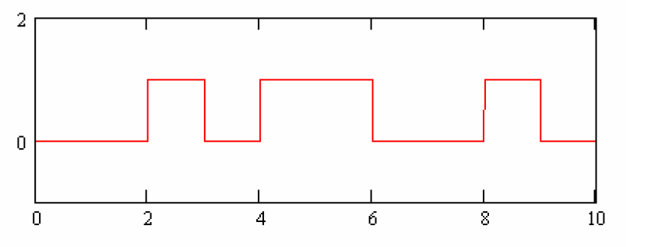
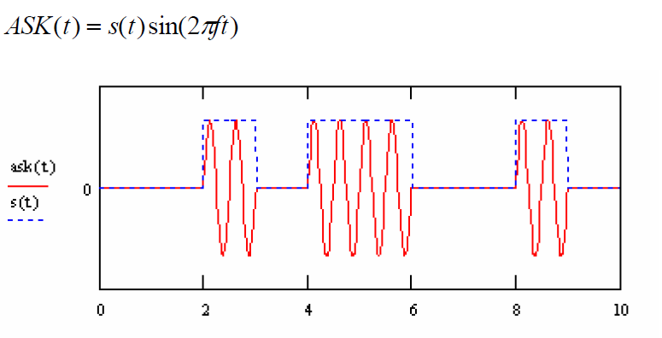
Binary ASK (Amplitude Shift Keying
ASK On-off keying (Amplitude Shift Keying) – frequency is kept constant, amplitude has 2 levels (for bit 1 and for bit 0)
The binary sequence 0010110010

Slide 40
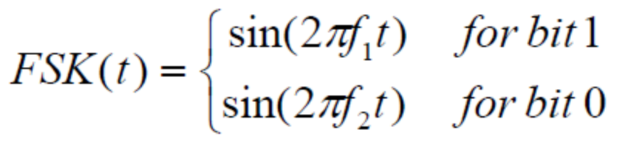
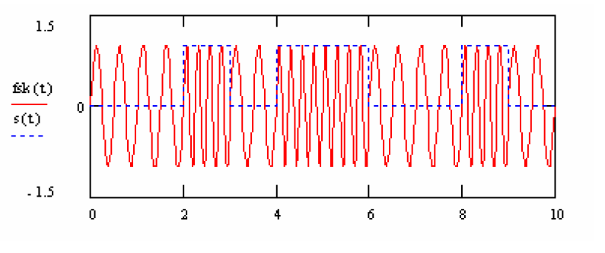
Binary FSK (Frequency shift keyring)
Instead of sin() functions, cos() functions can be used in the above formula.

Slide 41
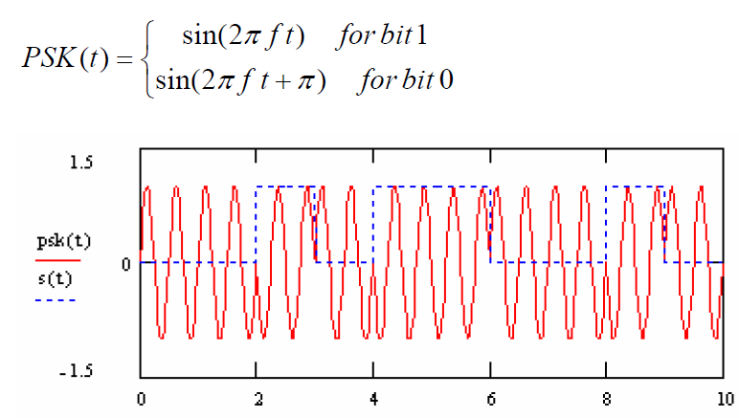
Binary PSK (Phase shift keyring)
Instead of sin() functions, cos() functions can be used in the above formula.

Slide 42
Complex digital modulation and demodulation

Slide 43
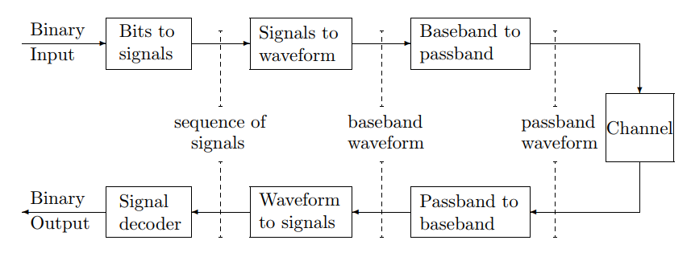
Complex digital modulation and demodulation

Slide 44
Complex digital modulation (simplified)
1) The binary input (from the source encoder) is converted to signals (i.e. vectors of real/complex numbers)
2) The signals are transformed/expanded into a waveform – continuous function of time (this waveform is computed using an orthonormal/orthogonal expansion, e.g. using values from the signals vector as coefficients of a Fourier Series waveform (computed using the Discrete Fourier Transform))
3) The resulted baseband waveform (i.e. centered around zero frequency) is then transformed into a passband waveform (i.e. a waveform centered around a higher frequency due to national and international regulations) – continuous function of time .

Slide 45
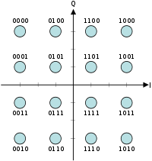
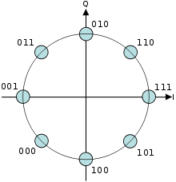

Step 1. Bits to signal
Incoming bits are segmented into b-bit blocks
b-bit blocks are mapped to a signal constellation A = {a₁, a₂, … a_{M}} where M=2^{b} possible blocks; each value of the signal constellation is called a signal(it is just a real/complex number)
Ex. of 1D signal constellation Ex. of 2D signal constellation:

Slide 46
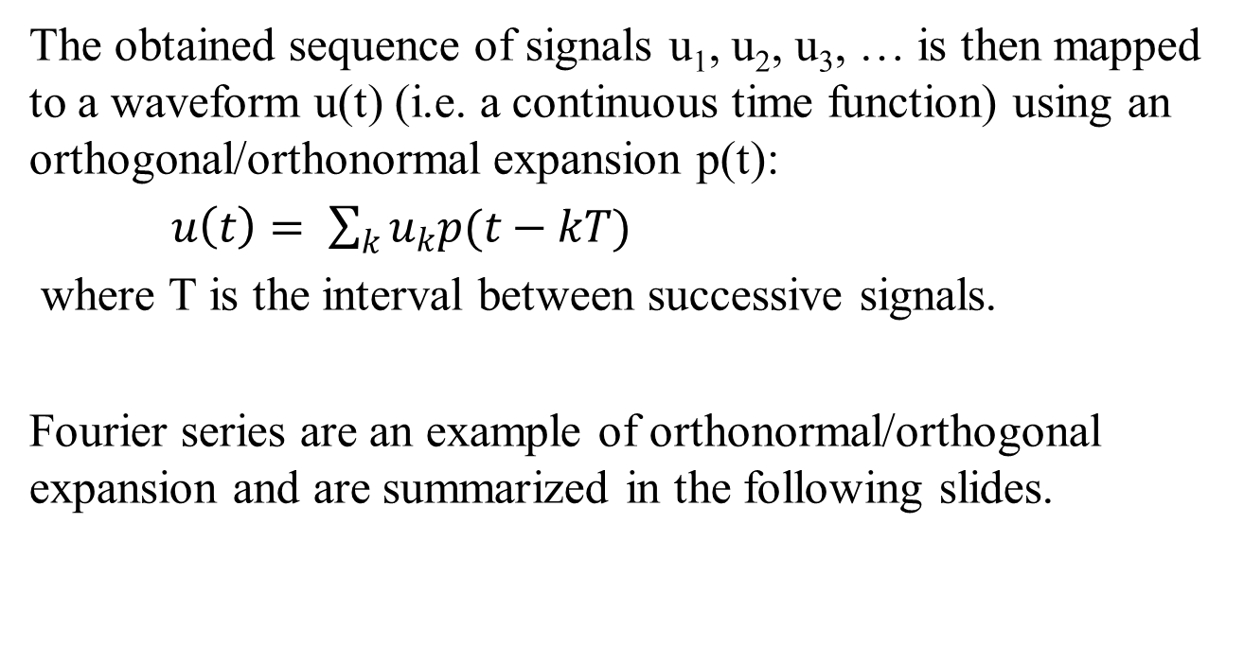
Step 2. Signals to waveform
The obtained sequence of signals u₁, u₂, u₃, … is then mapped to a waveform u(t) (i.e. a continuous time function) using an orthogonal/orthonormal expansion p(t):
$u\left(t\right)= \sum_{k}{u_{k}p(t−kT)}$
where T is the interval between successive signals.
Fourier series are an example of orthonormal/orthogonal expansion and are summarized in the following slides.

Slide 47
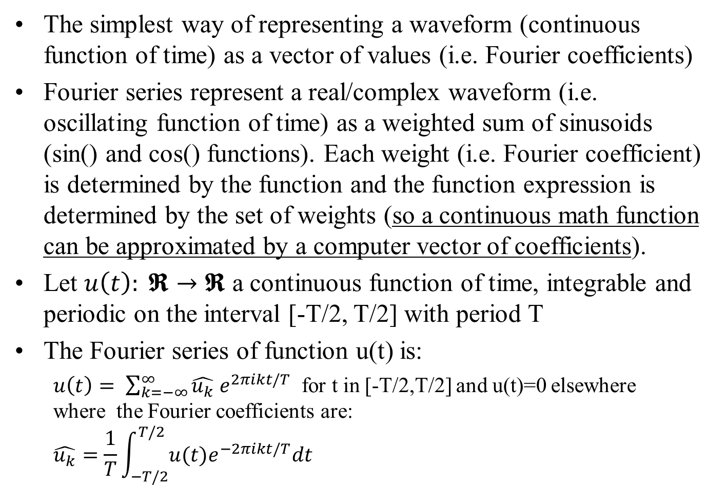
Fourier Series
The simplest way of representing a waveform (continuous function of time) as a vector of values (i.e. Fourier coefficients)
Fourier series represent a real/complex waveform (i.e. oscillating function of time) as a weighted sum of sinusoids (sin() and cos() functions). Each weight (i.e. Fourier coefficient) is determined by the function and the function expression is determined by the set of weights (so a continuous math function can be approximated by a computer vector of coefficients).
Let $u\left(t\right): 𝕽→𝕽$ a continuous function of time, integrable and periodic on the interval [-T/2, T/2] with period T
The Fourier series of function u(t) is:
  $u\left(t\right)= \sum_{k=−∞}^{∞}{\hat{u_{k}} e^{2πikt/T}}$ for t in [-T/2,T/2] and u(t)=0 elsewhere where the Fourier coefficients are:
  $$\hat{u_{k}}=\frac{1}{T}\int_{−T/2}^{T/2}{u(t)e^{−2πikt/T}dt}$$

Slide 48
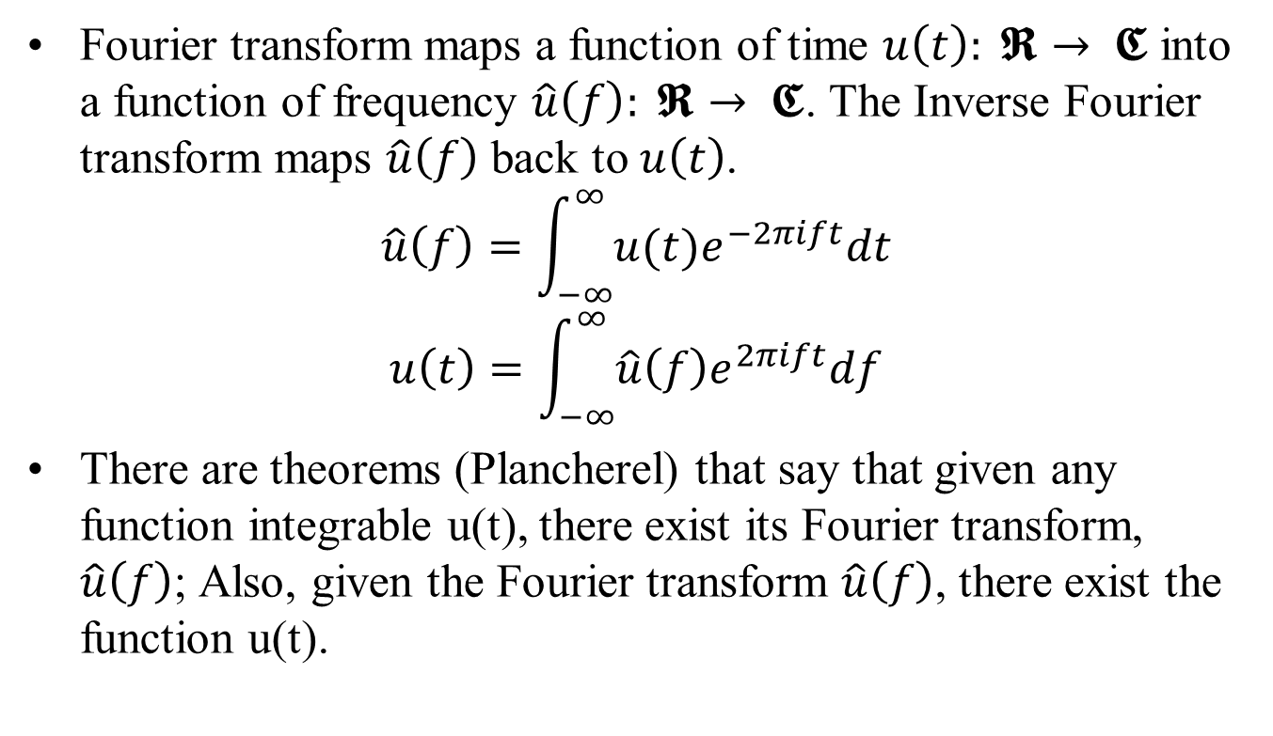
Fourier Transform
Fourier transform maps a function of time $u\left(t\right): 𝕽→ 𝕮$ into a function of frequency $\hat{u}\left(f\right): 𝕽→ 𝕮$. The Inverse Fourier transform maps $\hat{u}\left(f\right)$ back to $u\left(t\right)$.
$$\hat{u}\left(f\right)=\int_{−∞}^{∞}{u(t)e^{−2πift}dt}$$
$$u\left(t\right)=\int_{−∞}^{∞}{\hat{u}\left(f\right)e^{2πift}df}$$
There are theorems (Plancherel) that say that given any function integrable u(t), there exist its Fourier transform, $\hat{u}\left(f\right)$; Also, given the Fourier transform $\hat{u}\left(f\right)$, there exist the function u(t).

Slide 49
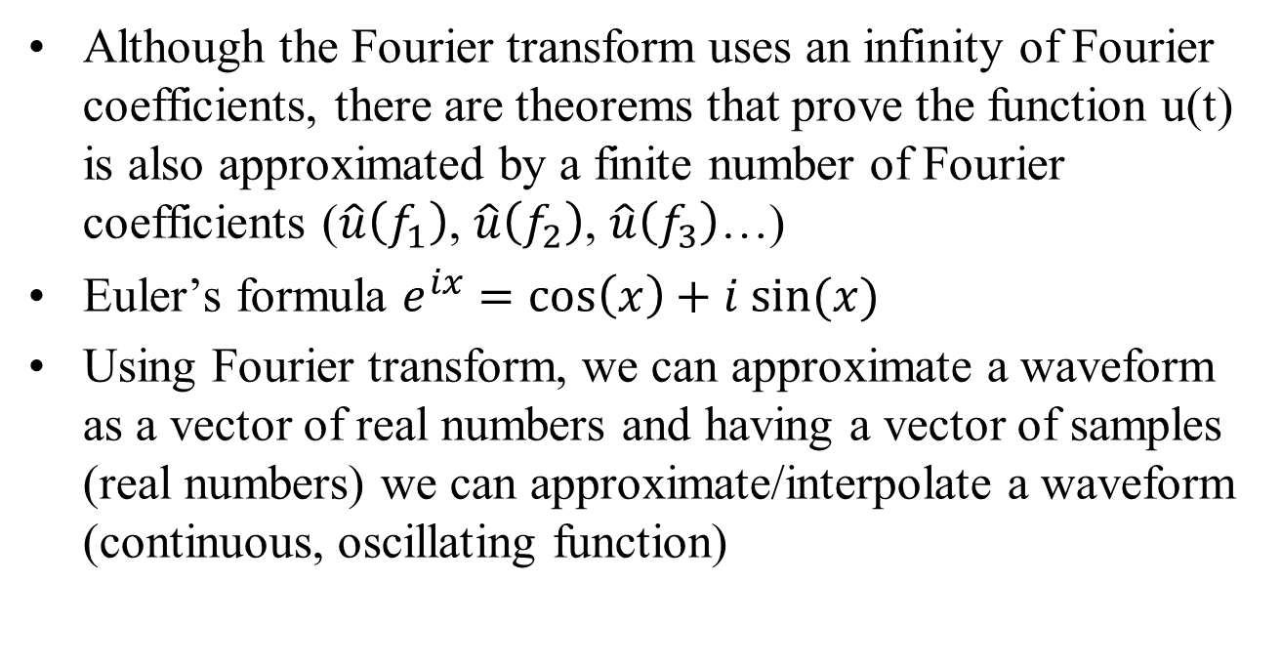
Fourier Transform (cont.)
Although the Fourier transform uses an infinity of Fourier coefficients, there are theorems that prove the function u(t) is also approximated by a finite number of Fourier coefficients ($\hat{u}\left(f_{1}\right)$, $\hat{u}\left(f_{2}\right)$, $\hat{u}\left(f_{3}\right)$…)
Euler’s formula $e^{ix}=\cos\left(x\right)+i sin⁡(x)$
Using Fourier transform, we can approximate a waveform as a vector of real numbers and having a vector of samples (real numbers) we can approximate/interpolate a waveform (continuous, oscillating function)

Slide 50
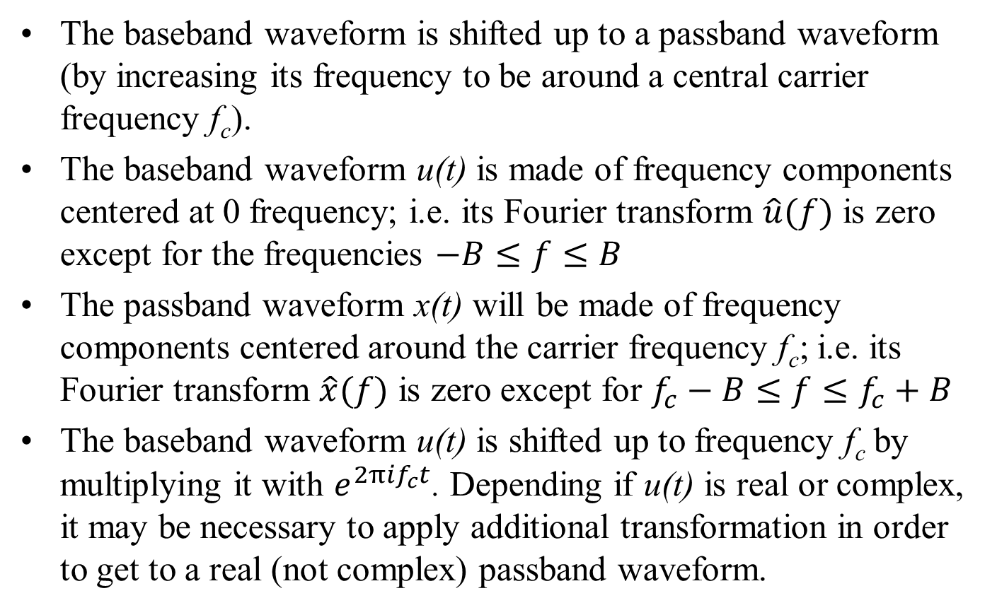
Step 3. Baseband to passband
The baseband waveform is shifted up to a passband waveform (by increasing its frequency to be around a central carrier frequency f_{c}).
The baseband waveform u(t) is made of frequency components centered at 0 frequency; i.e. its Fourier transform $\hat{u}(f)$ is zero except for the frequencies $−B≤f≤B$
The passband waveform x(t) will be made of frequency components centered around the carrier frequency f_{c}; i.e. its Fourier transform $\hat{x}(f)$ is zero except for $f_{c}−B≤f≤f_{c}+B$
The baseband waveform u(t) is shifted up to frequency f_{c} by multiplying it with $e^{2πif_{c}t}$. Depending if u(t) is real or complex, it may be necessary to apply additional transformation in order to get to a real (not complex) passband waveform.

Slide 51
Example of digital modulation techniques

Slide 52
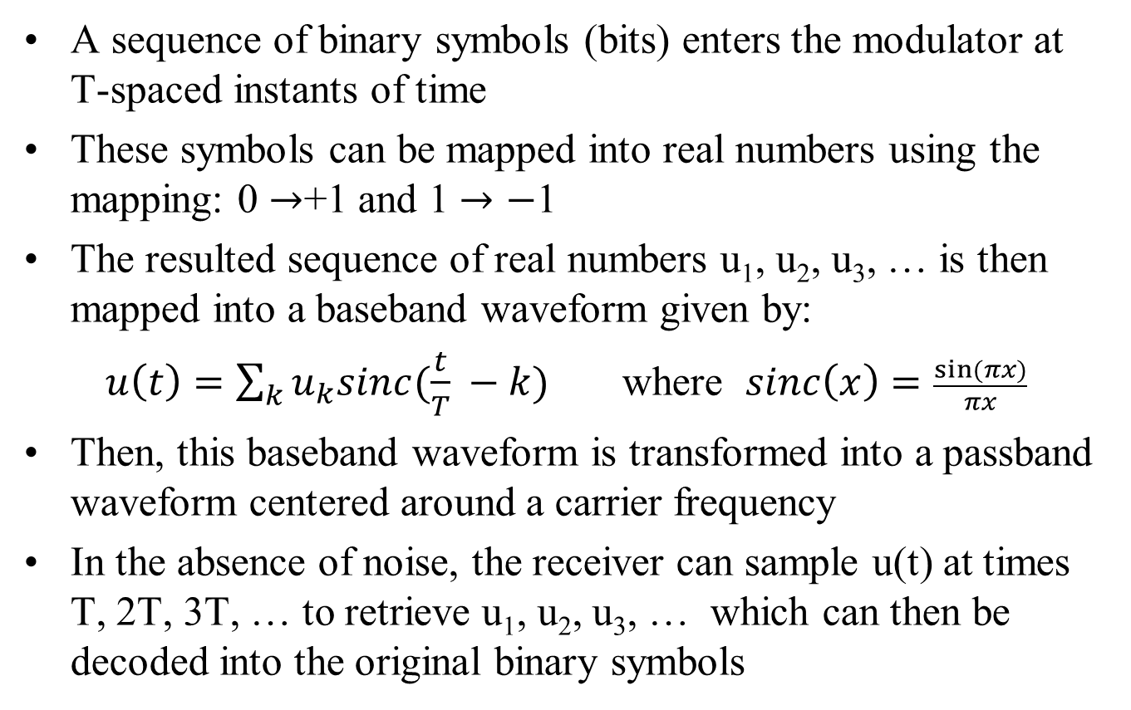
1. Simple example of binary modulation algorithm
A sequence of binary symbols (bits) enters the modulator at T-spaced instants of time
These symbols can be mapped into real numbers using the mapping: 0 $→$+1 and 1 $→−$1
The resulted sequence of real numbers u₁, u₂, u₃, … is then mapped into a baseband waveform given by:
$u\left(t\right)=\sum_{k}{u_{k}sinc(\frac{t}{T} −k)}$ where $sinc\left(x\right)=\frac{sin⁡(πx)}{πx}$
Then, this baseband waveform is transformed into a passband waveform centered around a carrier frequency
In the absence of noise, the receiver can sample u(t) at times T, 2T, 3T, … to retrieve u₁, u₂, u₃, … which can then be decoded into the original binary symbols

Slide 53
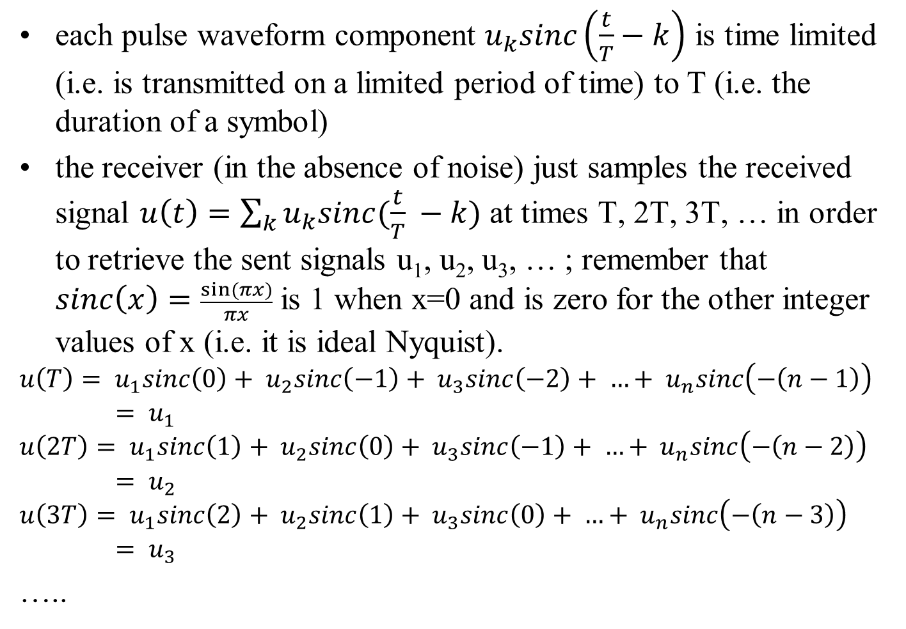
Simple example of binary modulation algorithm (part 2)
each pulse waveform component $u_{k}sinc\left(\frac{t}{T}−k\right)$ is time limited (i.e. is transmitted on a limited period of time) to T (i.e. the duration of a symbol)
the receiver (in the absence of noise) just samples the received signal $u\left(t\right)=\sum_{k}{u_{k}sinc(\frac{t}{T} −k)}$ at times T, 2T, 3T, … in order to retrieve the sent signals u₁, u₂, u₃, … ; remember that $sinc\left(x\right)=\frac{sin⁡(πx)}{πx}$ is 1 when x=0 and is zero for the other integer values of x (i.e. it is ideal Nyquist).
$$u\left(T\right)= u_{1}sinc\left(0\right)+ u_{2}sinc\left(−1\right)+ u_{3}sinc\left(−2\right)+ …+ u_{n}sinc\left(−\left(n−1\right)\right)= u_{1}$$
$$u\left(2T\right)= u_{1}sinc\left(1\right)+ u_{2}sinc\left(0\right)+ u_{3}sinc\left(−1\right)+ …+ u_{n}sinc\left(−\left(n−2\right)\right)= u_{2}$$
$$u\left(3T\right)= u_{1}sinc\left(2\right)+ u_{2}sinc\left(1\right)+ u_{3}sinc\left(0\right)+ …+ u_{n}sinc\left(−\left(n−3\right)\right)= u_{3}$$
…..

Slide 54
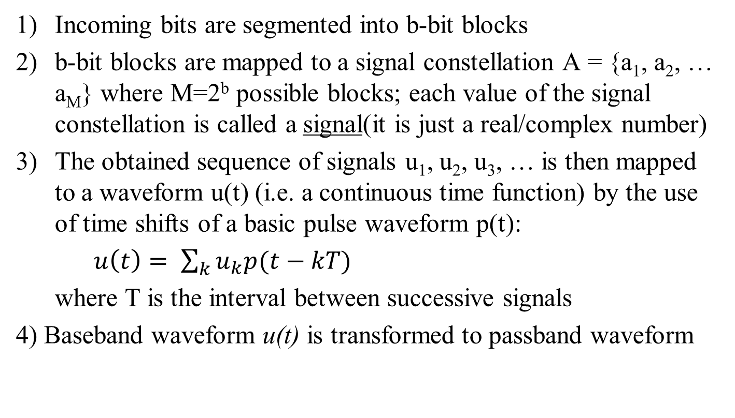
2. PAM (Pulse Amplitude Modulation)
Incoming bits are segmented into b-bit blocks
b-bit blocks are mapped to a signal constellation A = {a₁, a₂, … a_{M}} where M=2^{b} possible blocks; each value of the signal constellation is called a signal(it is just a real/complex number)
The obtained sequence of signals u₁, u₂, u₃, … is then mapped to a waveform u(t) (i.e. a continuous time function) by the use of time shifts of a basic pulse waveform p(t):
$u\left(t\right)= \sum_{k}{u_{k}p(t−kT)}$
where T is the interval between successive signals
4) Baseband waveform u(t) is transformed to passband waveform

Slide 55
1D signal constellation example for PAM
for 2 signals (bit blocks: 0 and 1):
-1, 1
for 4 signals (bit blocks: 00, 01, 10 and 11):
-3,-1,1,3
for 8 signals (bit blocks: 000, 001, 010, 011, 100, 101, 110, 111): -7,-5,-3-1,1,3,5,7
the distance between 2 signals in a signal constellation does not necessary need to be 2, but it should be a constant; for example, this is also a signal constellation with 4 signals: -9,-3,3,9

Slide 56
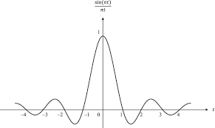
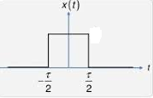
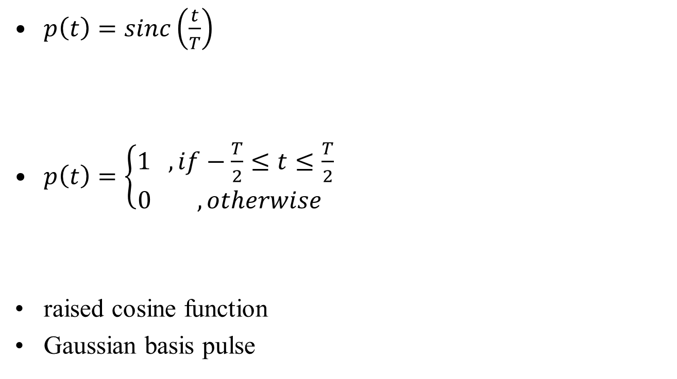
p(t) function example for PAM
$p\left(t\right)=sinc\left(\frac{t}{T}\right)$
$p\left(t\right)=\left\{\begin{aligned}1 ,if−\frac{T}{2}≤t≤\frac{T}{2} \\ 0 ,otherwise \end{aligned}\right.$
raised cosine function
Gaussian basis pulse

Slide 57
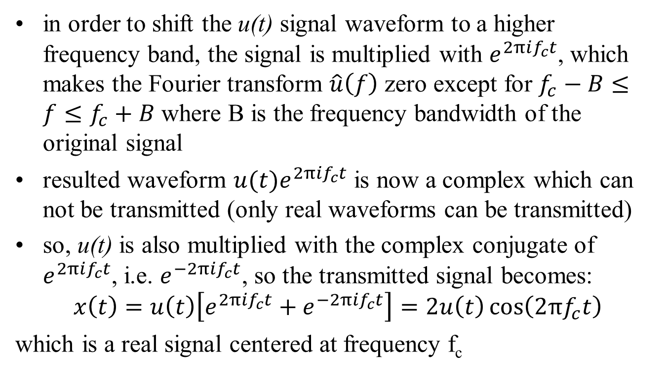
PAM passband transform
in order to shift the u(t) signal waveform to a higher frequency band, the signal is multiplied with $e^{2πif_{c}t}$, which makes the Fourier transform $\hat{u}\left(f\right)$ zero except for $f_{c}−B≤f≤f_{c}+B$ where B is the frequency bandwidth of the original signal
resulted waveform ${u(t)e}^{2πif_{c}t}$ is now a complex which can not be transmitted (only real waveforms can be transmitted)
so, u(t) is also multiplied with the complex conjugate of $e^{2πif_{c}t}$, i.e. $e^{−2πif_{c}t}$, so the transmitted signal becomes:
$$x\left(t\right)=u\left(t\right)\left[e^{2πif_{c}t}+e^{−2πif_{c}t}\right]=2u\left(t\right)\cos\left(2πf_{c}t\right)$$
which is a real signal centered at frequency f_{c}

Slide 58
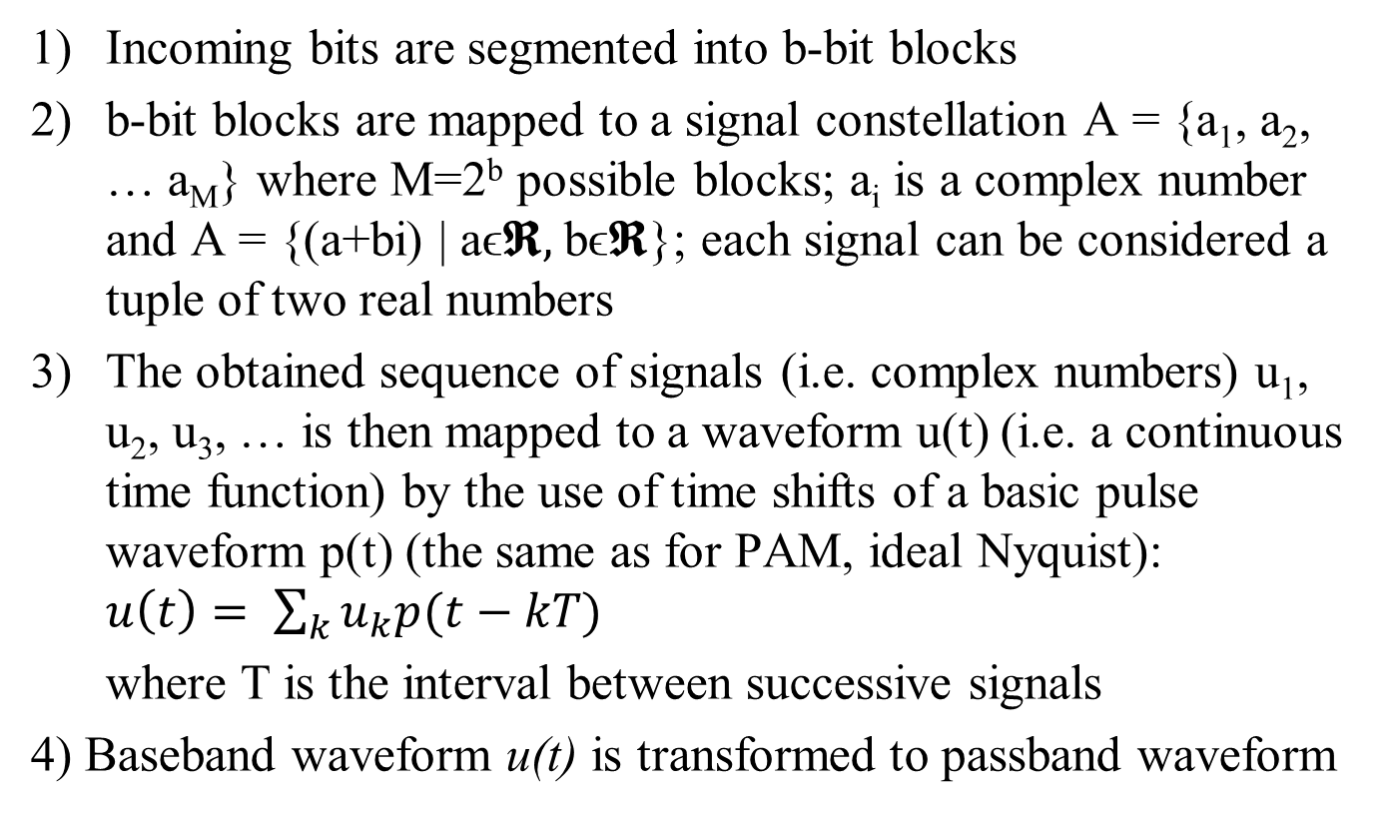
3. QAM (Quadrature Amplitude Modulation)
Incoming bits are segmented into b-bit blocks
b-bit blocks are mapped to a signal constellation A = {a₁, a₂, … a_{M}} where M=2^{b} possible blocks; a_{i} is a complex number and A = {(a+bi) | aϵ𝕽, bϵ𝕽}; each signal can be considered a tuple of two real numbers
The obtained sequence of signals (i.e. complex numbers) u₁, u₂, u₃, … is then mapped to a waveform u(t) (i.e. a continuous time function) by the use of time shifts of a basic pulse waveform p(t) (the same as for PAM, ideal Nyquist): $u\left(t\right)= \sum_{k}{u_{k}p(t−kT)}$
where T is the interval between successive signals
4) Baseband waveform u(t) is transformed to passband waveform

Slide 59
Constellation example for 16-QAM
One axis represents the in-phase component and the other represents the quadrature component

Slide 60
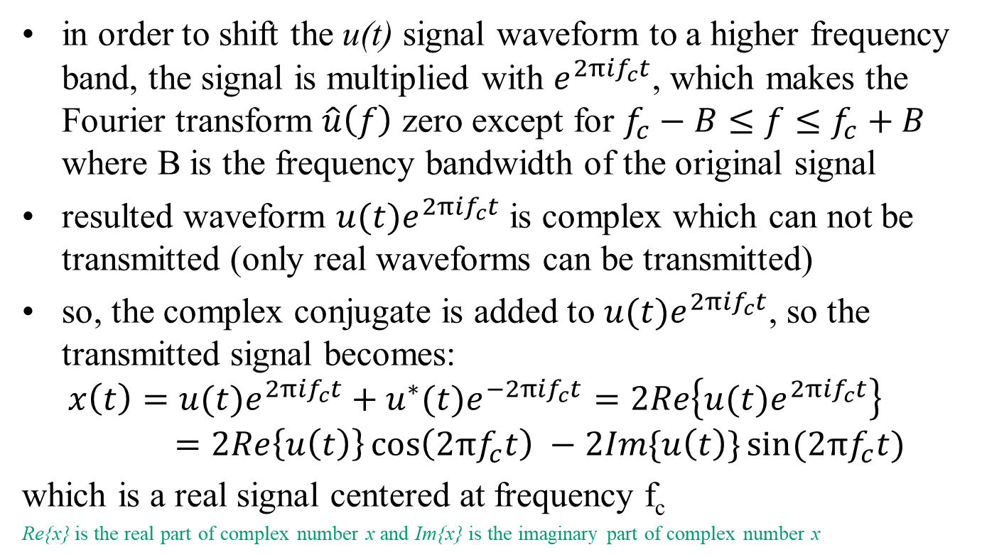
QAM baseband to passband
in order to shift the u(t) signal waveform to a higher frequency band, the signal is multiplied with $e^{2πif_{c}t}$, which makes the Fourier transform $\hat{u}\left(f\right)$ zero except for $f_{c}−B≤f≤f_{c}+B$ where B is the frequency bandwidth of the original signal
resulted waveform ${u(t)e}^{2πif_{c}t}$ is complex which can not be transmitted (only real waveforms can be transmitted)
so, the complex conjugate is added to ${u(t)e}^{2πif_{c}t}$, so the transmitted signal becomes:
$$x\left(t\right)={u(t)e}^{2πif_{c}t}+{u^{∗}(t)e}^{−2πif_{c}t}=2Re\left\{{u(t)e}^{2πif_{c}t}\right\}=2Re\left\{u\left(t\right)\right\}\cos\left(2πf_{c}t\right) −2Im\{u\left(t\right)\}sin⁡(2πf_{c}t)$$
which is a real signal centered at frequency f_{c}
Re{x} is the real part of complex number x and Im{x} is the imaginary part of complex number x

Slide 61
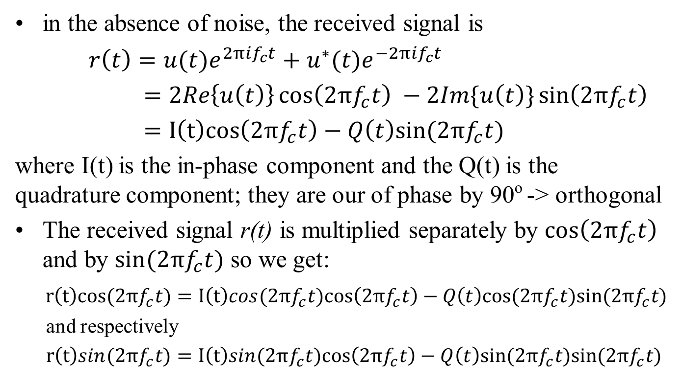
QAM decoder (part 1)
in the absence of noise, the received signal is
$r\left(t\right)={u(t)e}^{2πif_{c}t}+{u^{∗}(t)e}^{−2πif_{c}t}$
$=2Re\left\{u\left(t\right)\right\}\cos\left(2πf_{c}t\right) −2Im\{u\left(t\right)\}\sin\left(2πf_{c}t\right)$
$=I\left(t\right)cos\left(2πf_{c}t\right)−Q\left(t\right)sin⁡(2πf_{c}t)$
where I(t) is the in-phase component and the Q(t) is the quadrature component; they are our of phase by 90º -> orthogonal
The received signal r(t) is multiplied separately by $cos\left(2πf_{c}t\right)$ and by $sin(2πf_{c}t)$ so we get:
$r\left(t\right)cos(2πf_{c}t)=I\left(t\right)cos(2πf_{c}t)cos\left(2πf_{c}t\right)−Q\left(t\right)cos⁡(2πf_{c}t)sin⁡(2πf_{c}t)$
and respectively
$r\left(t\right)sin(2πf_{c}t)=I\left(t\right)sin(2πf_{c}t)cos\left(2πf_{c}t\right)−Q\left(t\right)sin⁡(2πf_{c}t)sin⁡(2πf_{c}t)$

Slide 62
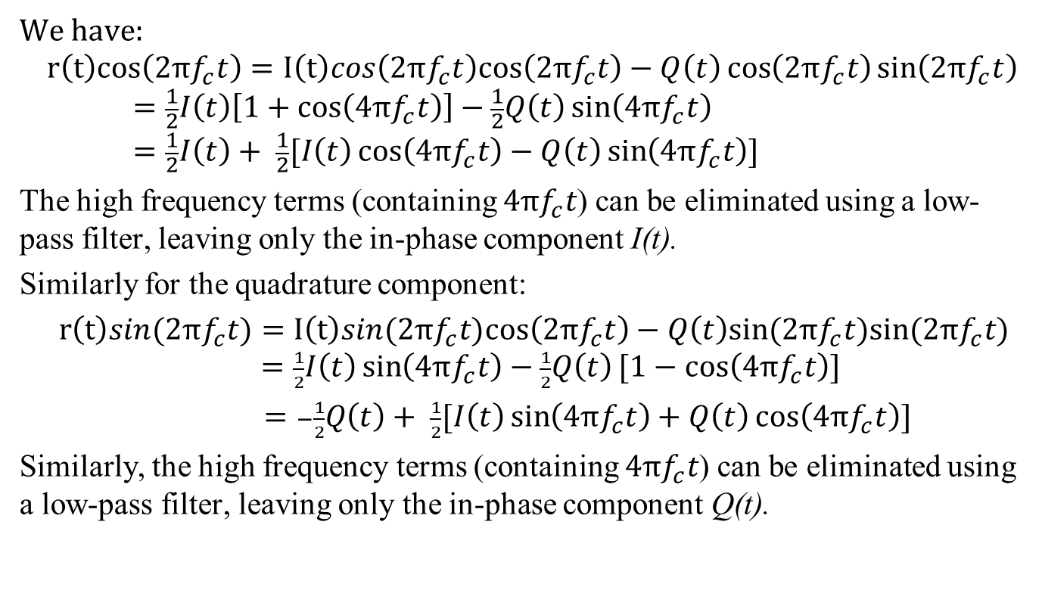
QAM decoder (part 2)
We have:
$$r\left(t\right)cos\left(2πf_{c}t\right)=I\left(t\right)cos\left(2πf_{c}t\right)cos\left(2πf_{c}t\right)−Q\left(t\right)\cos\left(2πf_{c}t\right)\sin\left(2πf_{c}t\right)=\frac{1}{2}I\left(t\right)\left[1+\cos\left(4πf_{c}t\right)\right]−\frac{1}{2}Q\left(t\right)\sin\left(4πf_{c}t\right)=\frac{1}{2}I\left(t\right)+ \frac{1}{2}[I\left(t\right)\cos\left(4πf_{c}t\right)−Q\left(t\right)\sin\left(4πf_{c}t\right)]$$
The high frequency terms (containing $4πf_{c}t$) can be eliminated using a low-pass filter, leaving only the in-phase component I(t).
Similarly for the quadrature component:
$r\left(t\right)sin(2πf_{c}t)=I\left(t\right)sin(2πf_{c}t)cos\left(2πf_{c}t\right)−Q\left(t\right)sin⁡(2πf_{c}t)sin⁡(2πf_{c}t)$ $=\frac{1}{2}I\left(t\right)\sin\left(4πf_{c}t\right)−\frac{1}{2}Q\left(t\right)[1−cos\left(4πf_{c}t\right)]$
$=−\frac{1}{2}Q\left(t\right)+ \frac{1}{2}[I\left(t\right)\sin\left(4πf_{c}t\right)+Q\left(t\right)\cos\left(4πf_{c}t\right)]$
Similarly, the high frequency terms (containing $4πf_{c}t$) can be eliminated using a low-pass filter, leaving only the in-phase component Q(t).

